Slide 1
Week 6 Presentation
Wednesday, October 2, 2019
ATLAS Data analyst team:
Smruthi Iyengar
Kagen Jet Quiballo
Hanqing Wang
Yuxin Wang
Notes:
Greets, ladies and gentlemen. Welcome to our week 6 presentation. We are ATLAS Data Mining team. [self intro based on the list, name, major, title] The objective of this project is to study what impacts students’ matriculation from a financial perspectives.

Slide 2
Introduction
Overview dropout from Fall 17 to SP 19
Dropout rate by different group (Freshmen, Transfer, Continued)
Dropout rate by College
Dropout caused by hold
Dropout rate by Residency
Notes:
For this week, first we are going to talk about the overview dropout from fall 17 all the way to Sp19 semester by semester. Then, we are going to focus on the dropout rate based on specific categories, like dropout rate by different groups, by colleges, by hold and by residency. Thus, I will leave the stage to Kagen.

Slide 3
METHODS
UNDERGRADS
accurate & representative
accurate from last week
matched demographics within 0.5%
no blanks → blanks
no blanks → blanks + 0s
yielded same results
example
blanks in S18 →
look for refund during
active term (F17)
CREDIT HOURS
no blanks → blanks
REFUND
for corresponding term
Notes:
First talk about the methods → start with yellow, then blue, then green

Slide 4
UG DROPOUT BY SEMESTER
Total dropout from F17 to S19
4,752 = 25.0%
F17
S18
F18
S19
18,976
(100%)
17,745
(93.5%)
15,200
(80.1%)
14,224
(75.0%)
dropout: 1,231
previous: 6.49%
overall: 6.49%
dropout: 2,545
previous: 14.3%
overall: 13.4%
dropout: 976
previous: 6.42%
overall: 5.14%
Notes:
Start with total. Talk a little bit about each semester jump
Then the trend of spring to fall dropout
Hanqing will talk break it down by freshmen, tranfers, and continuing students

Slide 5
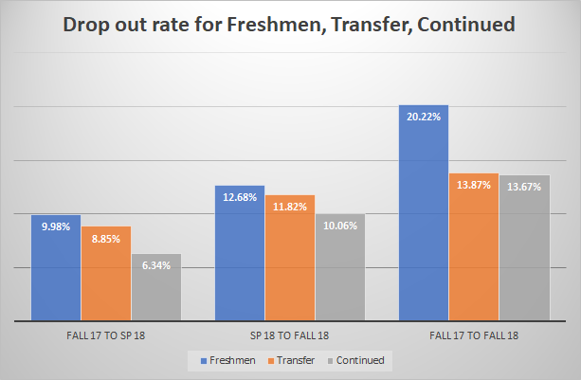
Notes:
Next, we computed dropout rate for three different groups during three different time periods. Three groups include Freshmen, Transfer and Continued. Three periods include Fall 17 to Sp 18, Sp 18 to Fall 18 and Fall 17 to Fall 18. Based on the graph, We can see the freshmen always have the highest dropout rate. We also computed the dropout rate from fall 17 to fall 18. From the graph, we can say the first year freshmen are more likely to drop out of college than other two groups. They are more likely dropping out of the college after spring semester than dropping out after fall. The continued college students have the lowest dropout rate. In the next slide, we will look at the dropout rate by college. I will leave the speaker to Yuxin

Slide 6
By college
Fall 2017 to Fall 2018
Method
Liberal Art & Science : 31.02%
Engineering : 29.47%
Business : 30.78%
Combine Account & CollegeInfo & CreditHour sheets
Find students who have 0 credit at Fall 2018 but don’t have 0 credit hours at Fall 2017
Look for refund during active terms

Slide 7
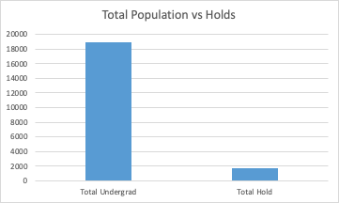
Percent of Undergrads that had a Hold (Fall 2017)
9 percent of undergraduates had a hold in Fall 2017

Slide 8
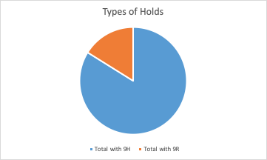
Distribution of the Types of Holds
A Majority (84%) of the holds are 9H
16%
84%

Slide 9
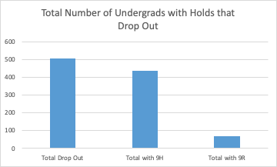
Holds That Lead to Drop Outs
3 percent of students (504 people) did not continue from Fall 2017 to Fall 2018 and had a hold on their account.
87 percent of these students had a 9H Hold

Slide 10
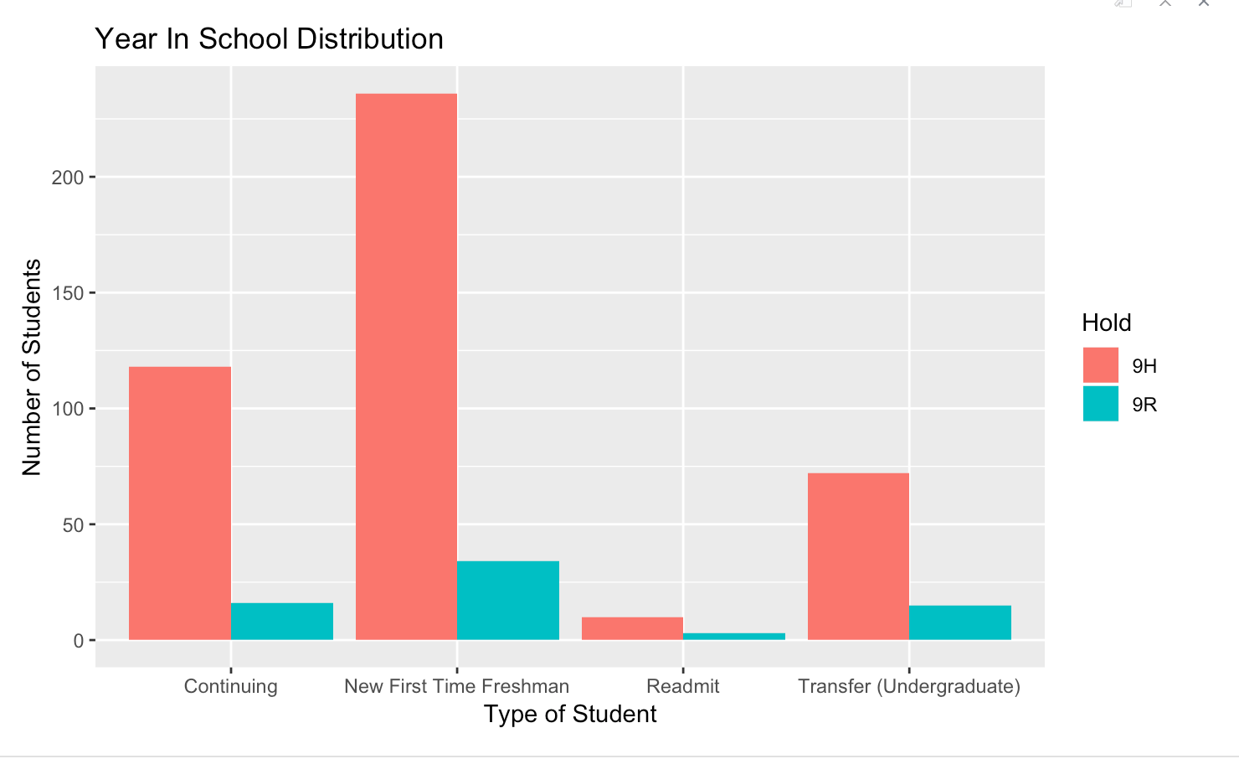
Holds that Lead to Drop Outs

Slide 11
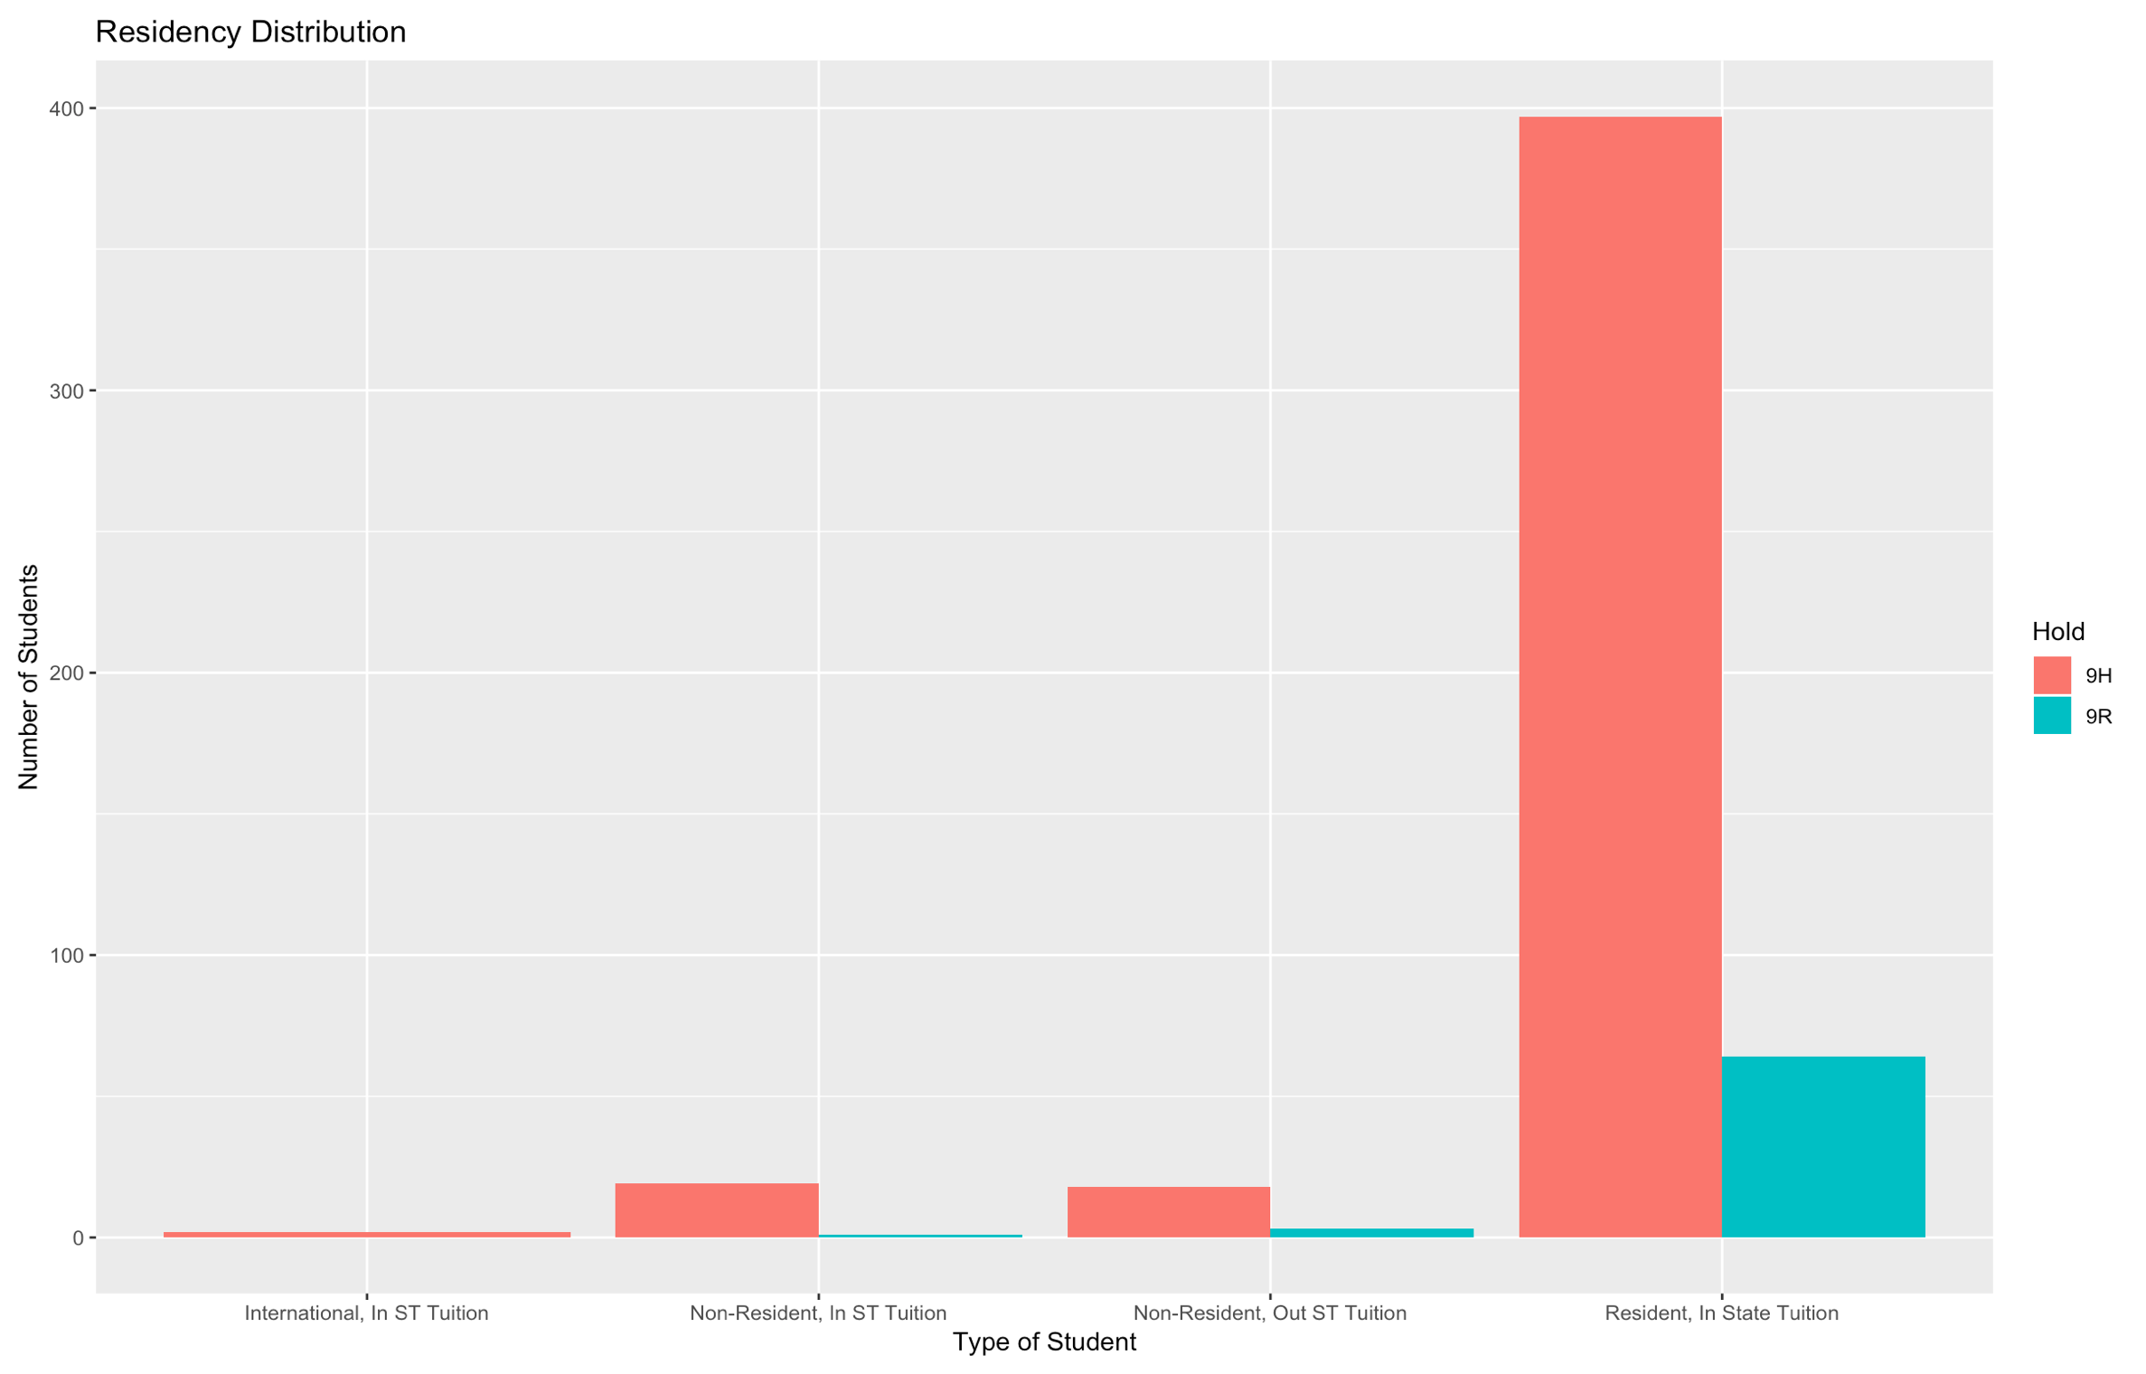
By Residency
91% are In state Students

Slide 12
Conclusion
Total dropout for undergrads from F17 to S19 was 25% (most of which were from S18 to F18)
Students tend to drop out after spring semester. First year Freshmen has highest dropout rate.
LAS, Engineering, and Business have similar dropout rate from F17 to F18
Holds that lead to dropout- Most that dropout are instate freshmen.

Slide 13
Thank you for listening!
Questions?

